Slide 1

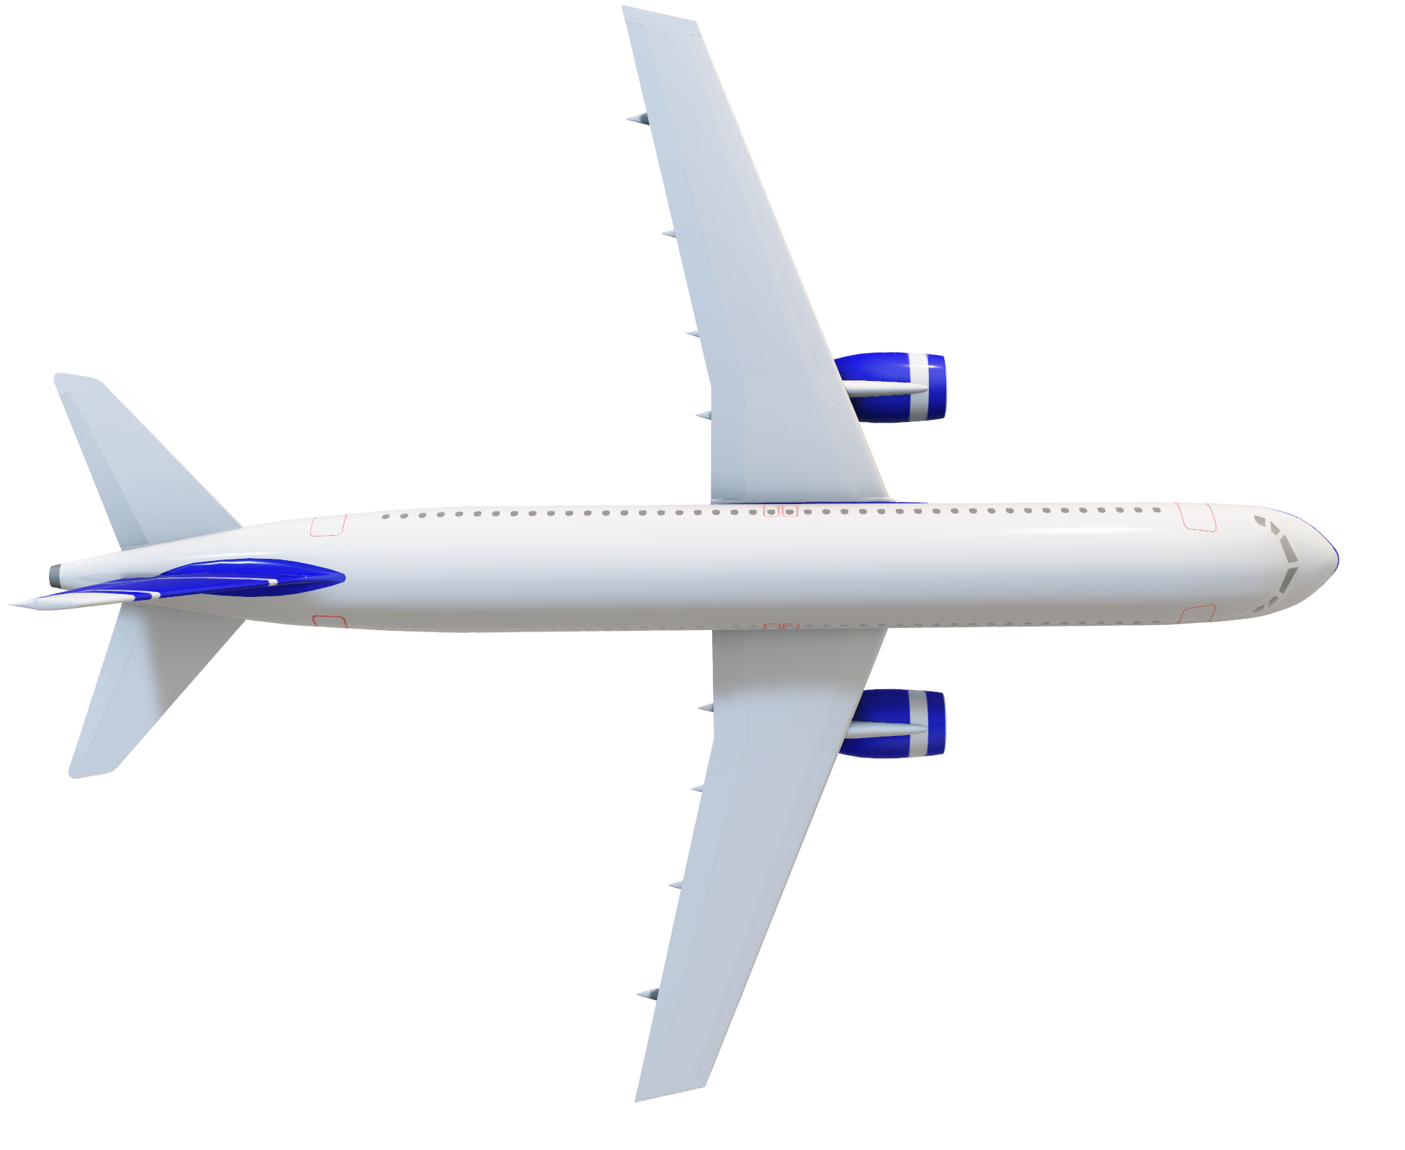

AIRPLANE PASSENGER SATISFACTION
GOOD MORNING
ADHILSHA N A

Slide 2
Airplane Passenger Satisfaction Prediction
This presentation details an end-to-end data science project focused on analyzing airline passenger feedback to understand satisfaction levels, identify key influencing factors, and build a predictive model. We utilized a range of Python libraries for data processing, analysis, and model building. The final model was deployed as Streamlit application.

Slide 3




Project Objectives
Analyze Feedback
Identify Key Factors
Understand passenger satisfaction levels through detailed analysis of feedback.
Pinpoint the most significant factors that influence passenger satisfaction.
Build Predictive Model
Develop a model to accurately classify and predict passenger satisfaction.

Slide 4

Dataset Overview & Preprocessing
Dataset Details
Data Preprocessing Steps
Source: Kaggle
Handled missing values (with median).
Rows: 129880
Encoded categorical variables using Label Encoding
Columns: 24
Feature scaling using MinMaxScaler
Target Variable: Satisfaction (Satisfied / Dissatisfied)
Feature selection using Recursive Feature Elimination (RFE)

Slide 5
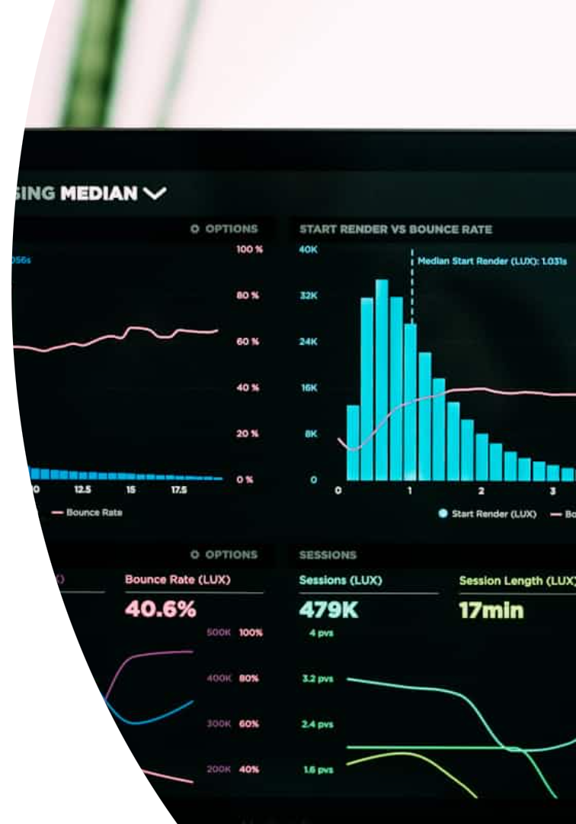



Exploratory Data Analysis (EDA)
Visualized Distributions
Distributions of class and gender were visualized to understand passenger demographics.
Correlation
Using correlation to identify relationships with
the target variable.
Satisfaction Rates
Satisfaction rates were analyzed across travel class, Wi-Fi availability, seat comfort, and inflight service, etc..
Key findings from EDA revealed that Business Class Passengers reported higher satisfaction, But Economy Class Passengers are reported lower satisfaction. And some passengers are rating on their basis

Slide 6




Model Building & Tuning
Pipeline Construction
Pipeline was built, integrating scaling, feature selection, and model building.
Models Explored
Various machine learning models were tested, including Logistic Regression, K-Nearest Neighbors, SVM, Decision Tree, Random Forest, AdaBoost, GradientBoost, and XGBoost.
Hyperparameter Tuning
RandomizedSearchCV was employed for efficient hyperparameter tuning to optimize model performance.

Slide 7
PIPELINE
1. Scaler
‘Scaling’, MinMaxScaler()()
2. Feature Selection
‘fearture_selection’, RFE(estimator=
RandomForestClassifier(criterion=‘entropy’, random_state=42), n_features_to_select=17))
3. Classifier
‘classification’,RandomForestClassifier(criterion=‘entropy’, max_depth=20, min_sample_leaf=6, n_estimators=75, random_state=42)

Slide 8

Model Evaluation Metrics
Core Metrics
Detailed Reports
Accuracy, Precision, Recall, and F1-score were used to assess model performance comprehensively.
A confusion matrix and classification report provided deeper insights into model predictions.
Binary Classification
ROC-AUC was specifically utilized for evaluating the performance of our binary classification model.

Slide 9
Models and their Accuracy Score
Random Forest
Decision
Tree
XGBoost
Stacking
SVC
96.30%
96.22%
95.21%
95.13%
94.55%
Gradient
Boosting
K-Nearest
Neighbors
Logistic
Regression
Naive
Bayes
Adaboost
94.24%
91.01%
87.39%
86.15%
92.82%

Slide 10
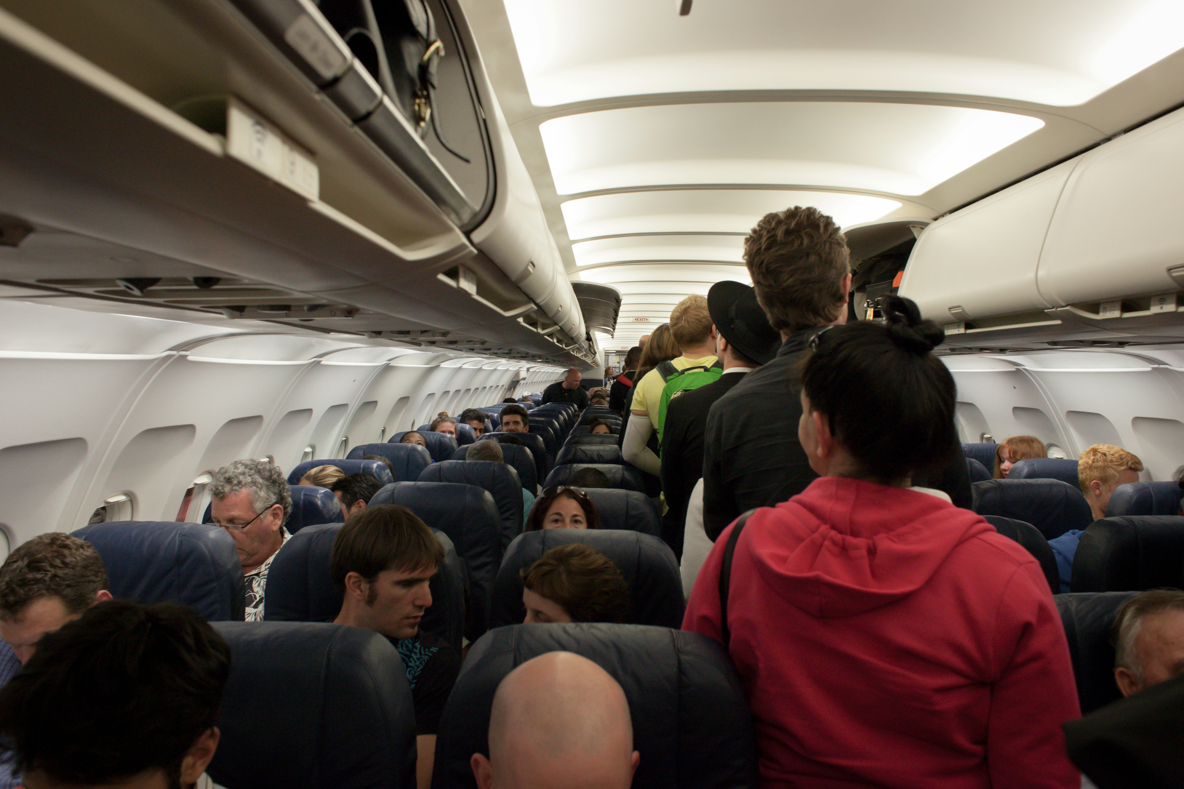
Optimizing for Passenger Satisfaction
96.30%
Accuracy
Achieved with the RandomForestClassifier, demonstrating high predictive power.
The RandomForestClassifier emerged as the best performing model, achieving an impressive accuracy (96.30%) in predicting passenger satisfaction. Our analysis identified Economy Class Passengers not satisfied the services they only give importance to Business class Passengers. Focusing on improvements in these key areas will significantly enhance the in-flight experience and lead to higher overall passenger satisfaction.

Slide 11

Key Insights & Conclusion
Key Insights
Provide Economy Class and Economy Plus Passengers have
get enough services and many areas for improvement.
Travel class significantly influences passenger satisfaction.
The predictive model can proactively identify dissatisfied passengers.
When the model became overfitted, I edit the parameter of RandomForestClassifier. Then the overfitted was remove.
Conclusion
Using Pipeline I built a Prediction Model from raw data to deployment. So that Airline Business have an idea about their service is satisfied or not to the Passenger.
Achieved 96.30% accuracy with the RandomForestClassifier.

Slide 12
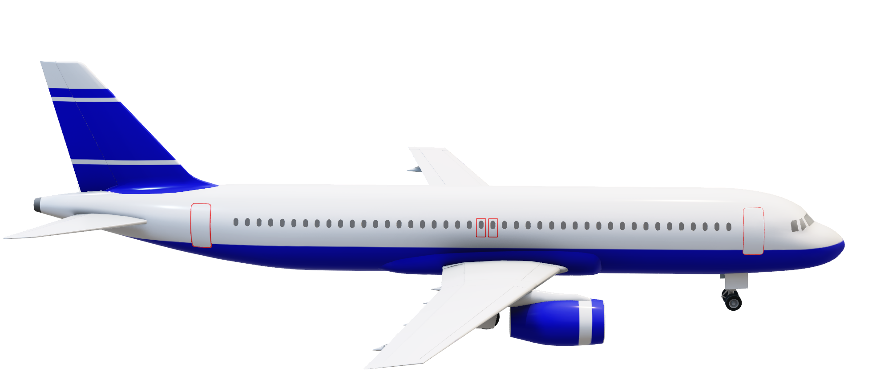
Thank You

